Slide 1



Slide 2

Review of the Language
Martian language that uses base 8 arithmetic and ”alien terminology”
Utilizes the PLY and YACC libraries in Python for the implementation of the lexer and parser
Divided into three files: Lexer, Parser, Interpreter
Notes:
ALEX

Slide 3
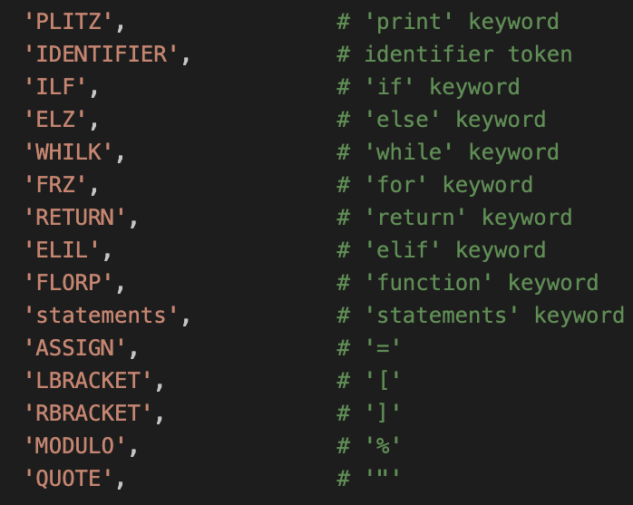
Changes to our Original Design
No longer need to define the type of a variable at its creation
Semicolons are only used to break up the three sections of a for loop (frz loop)
Use && and || for AND/OR logical comparisons instead of the actual word
Notes:
NOLAN

Slide 4
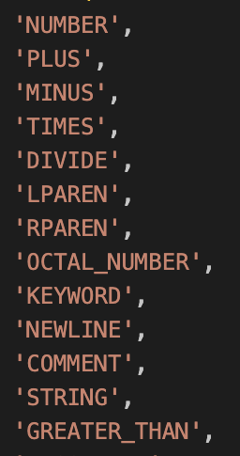
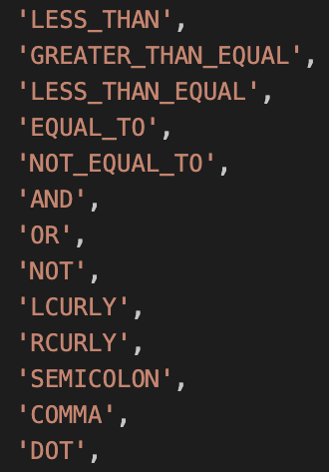
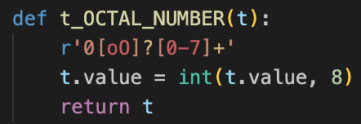
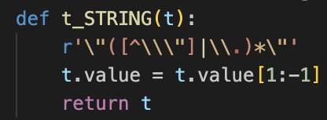
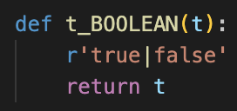
Other Keywords and Grammar Rules
Notes:
NOLAN

Slide 5
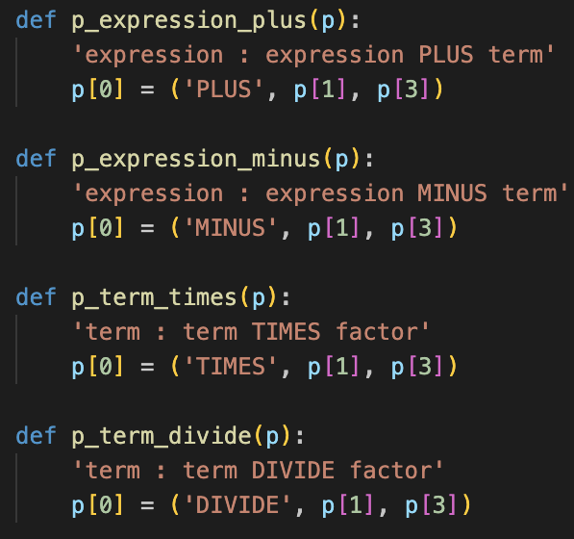
Update of the Parser
Many more rules have been created to allow for a more accurate Abstract Syntax Tree
Can handle for/while loops, if-elif-else statements, function creation and calling, variable creation, base 8 arithmetic, multiline code, logical comparison, mathematical comparison, and more
Notes:
ALEX

Slide 6
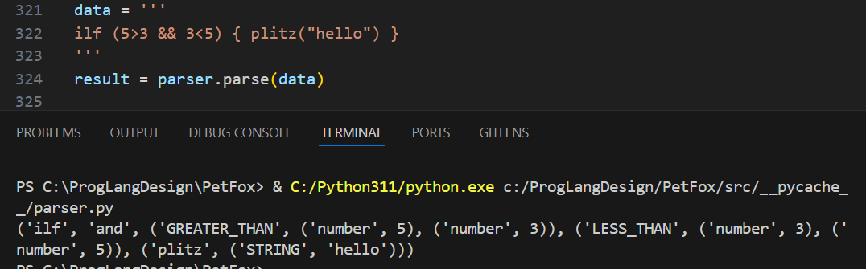
Abstract Syntax Tree
Example code:
ilf (5 > 3 || 3 < 5) { plitz(“hello”) } elz { plitz(“world”) }
This produces the Abstract Syntax Tree:
(‘ilf-elz’, ‘or’, (‘GREATER_THAN’, (‘number’, 5), (‘number’, 3)), (‘LESS_THAN’, (‘number’, 3), (‘number’, 5)), (‘plitz’, (‘STRING’, ‘hello’)), (‘plitz’, (‘STRING’, ‘world’)))
Notes:
NOLAN

Slide 7
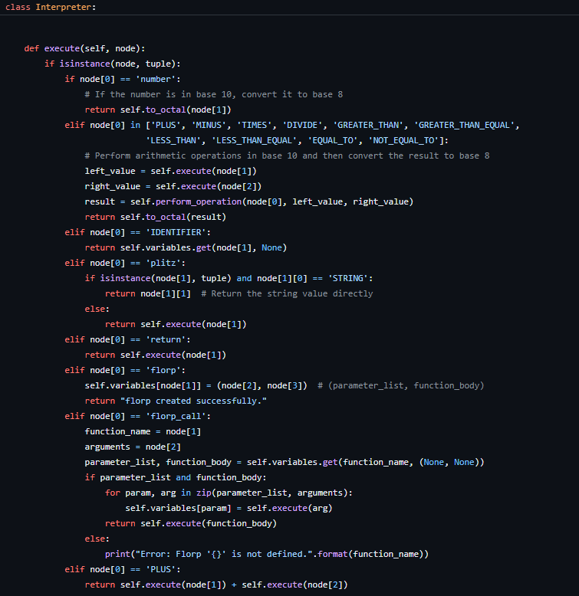
Interpreter
Code is typed into the terminal and users type exit to execute the code
Input -> Lexer -> Parser -> Execute() -> Result
The result of the code appears in the following line in the format of: ”Result: ___”
Notes:
ALEX

Slide 8
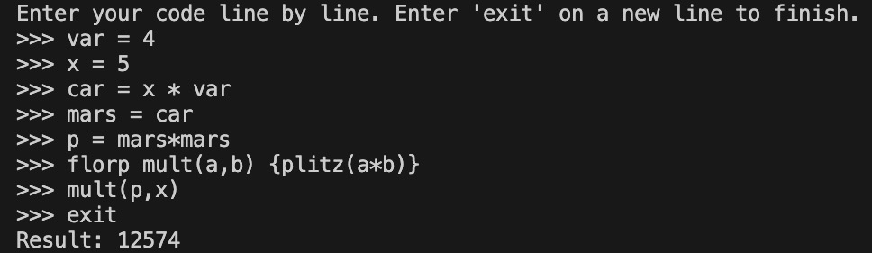
Example Usage
Notes:
NOLAN

Slide 9
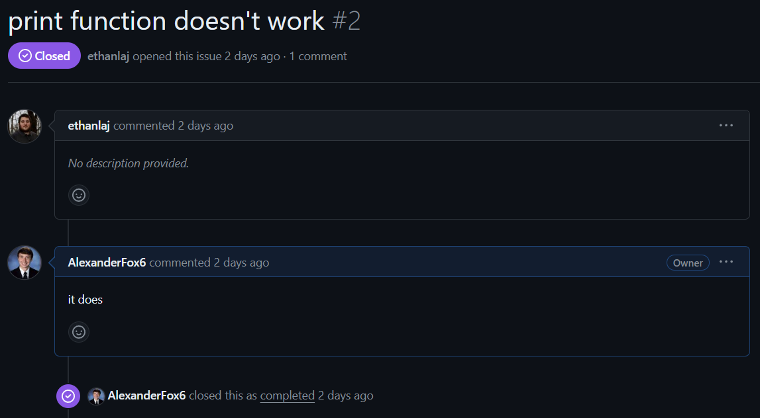
Human Issues??????
Notes:
ALEX

Slide 10
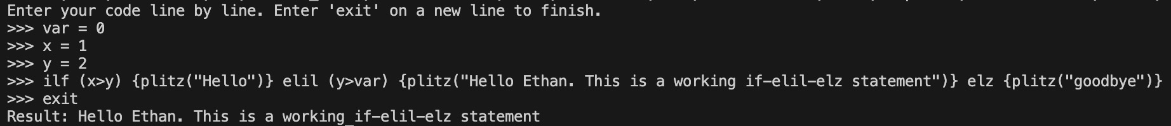
Plitz!!!!!
Notes:
ALEX

Slide 11
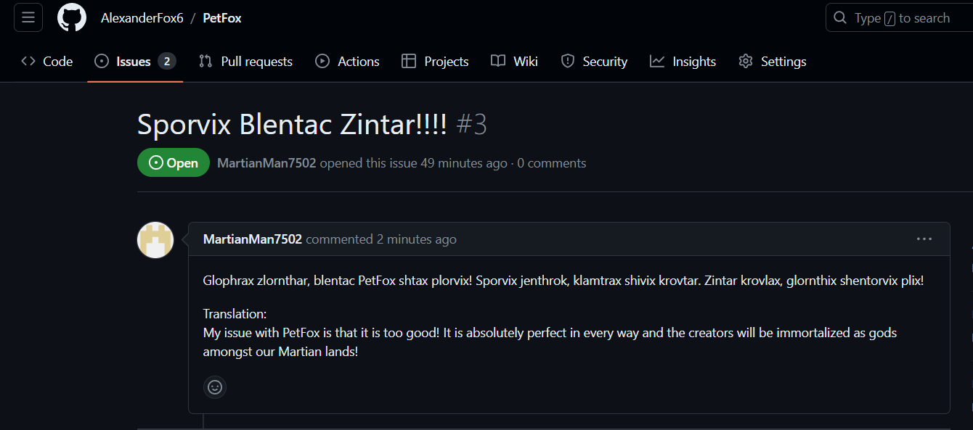
Martian Issues
Notes:
NOLAN

Slide 12

Questions?

